Slide 1
Andrew Fulton
Portfolio Site

Slide 2
Tech Stack
HTML + SASS
HTML + CSS
GitHub
Netlify

Slide 3
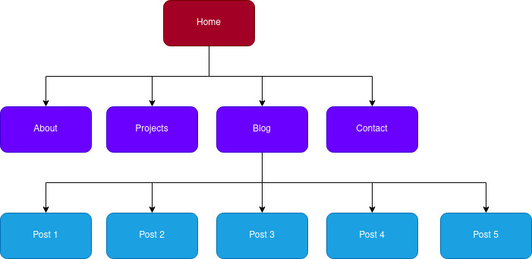

Slide 4
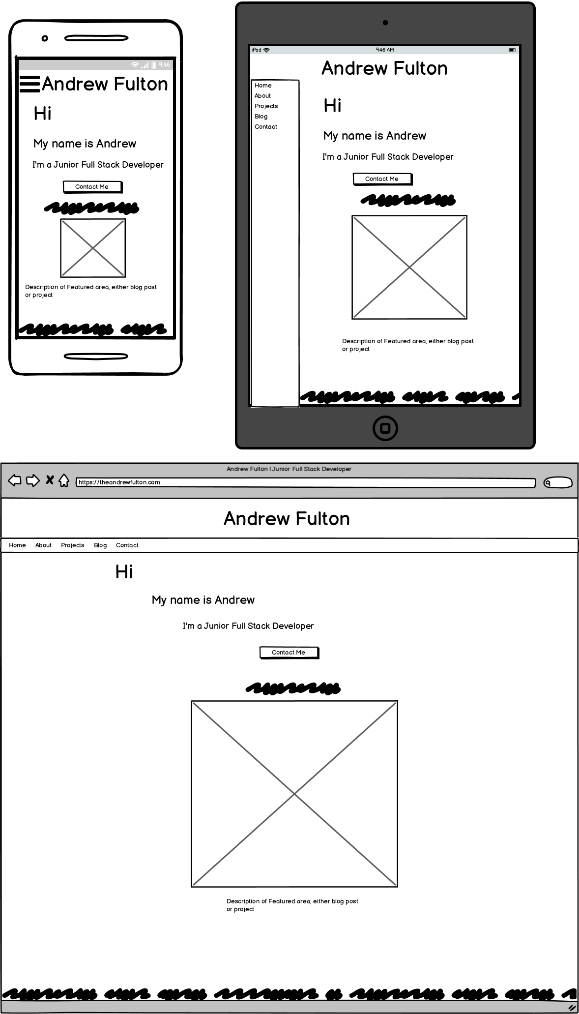

Slide 5
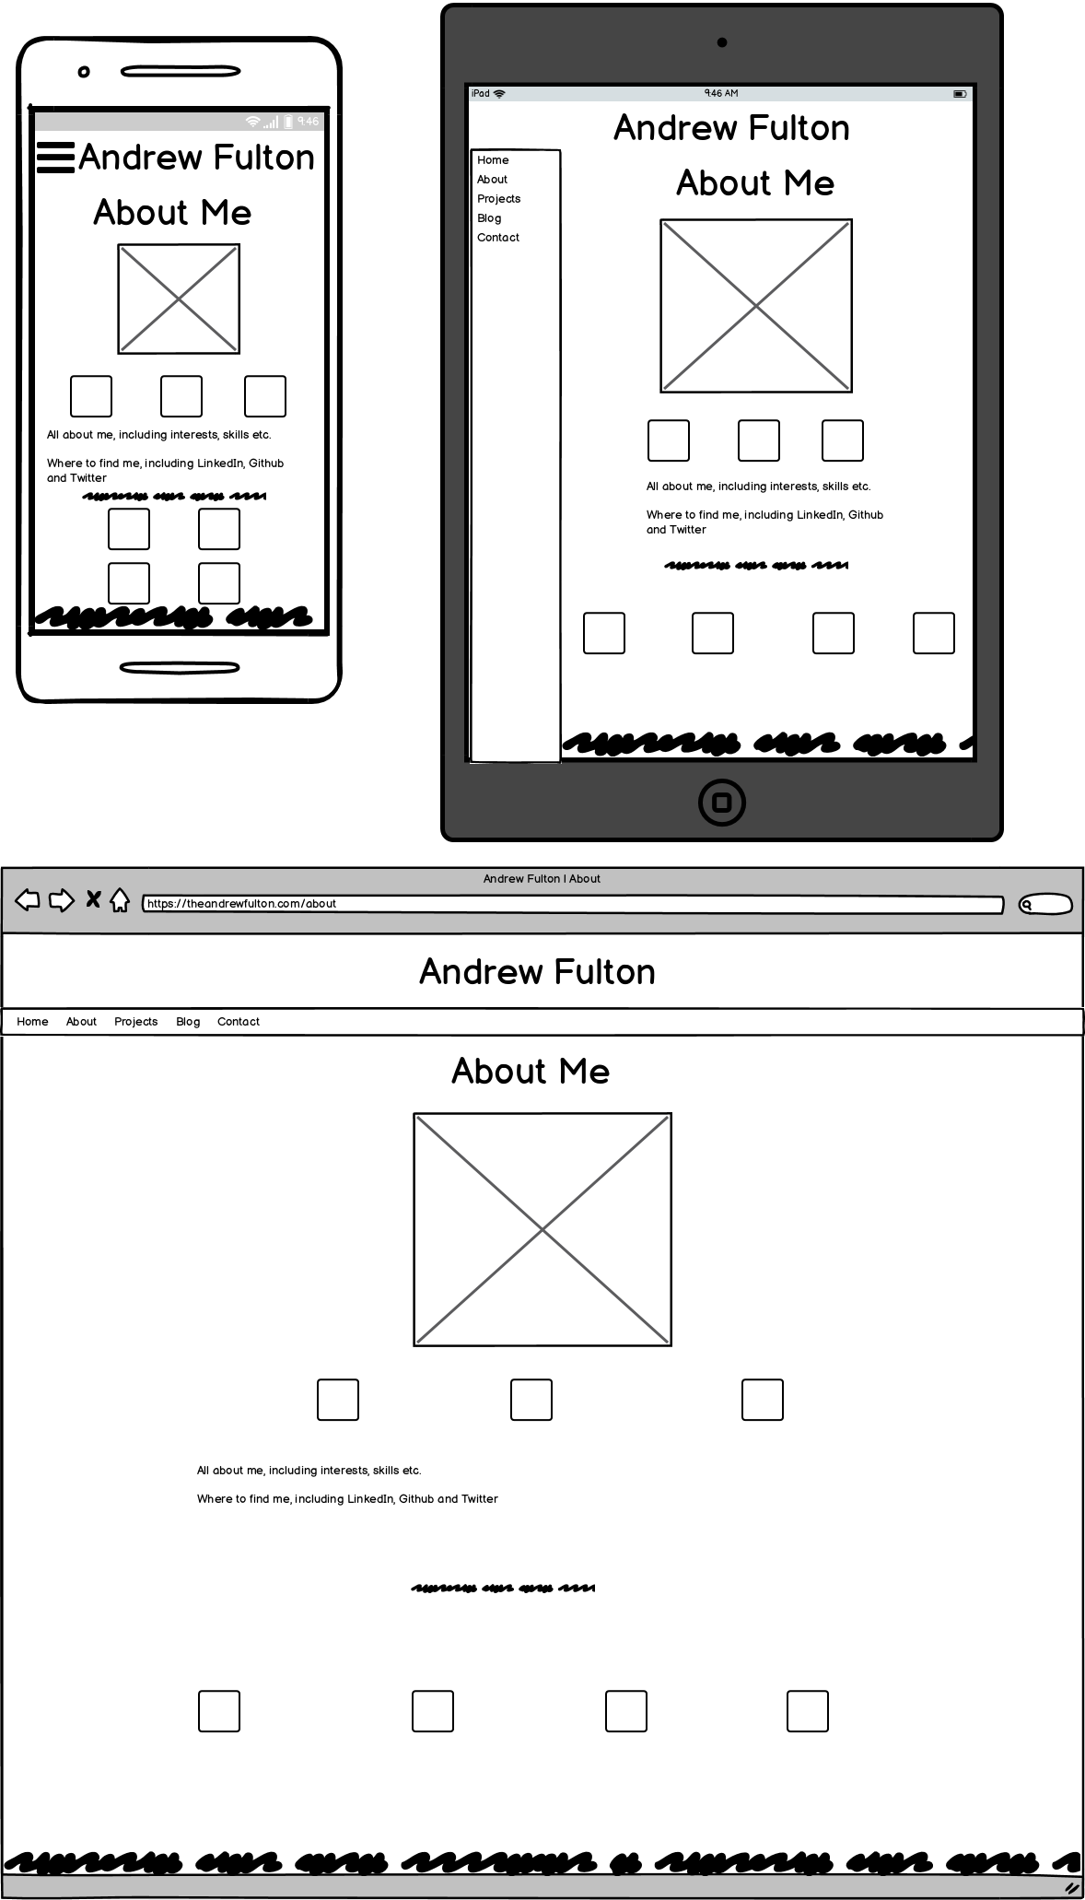

Slide 6
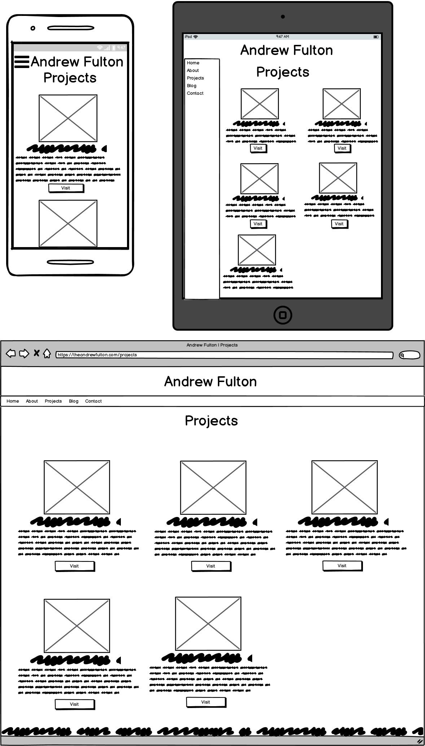
Remove this?

Slide 7
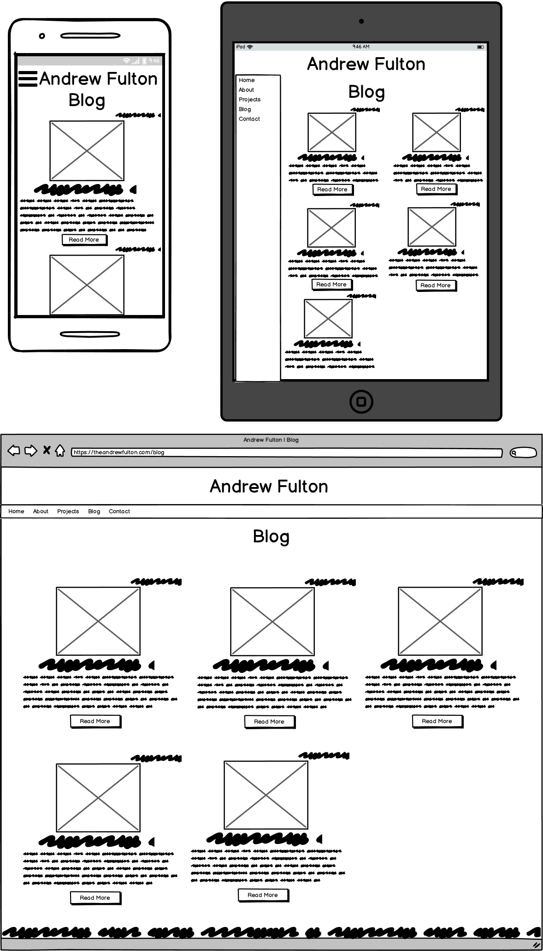

Slide 8
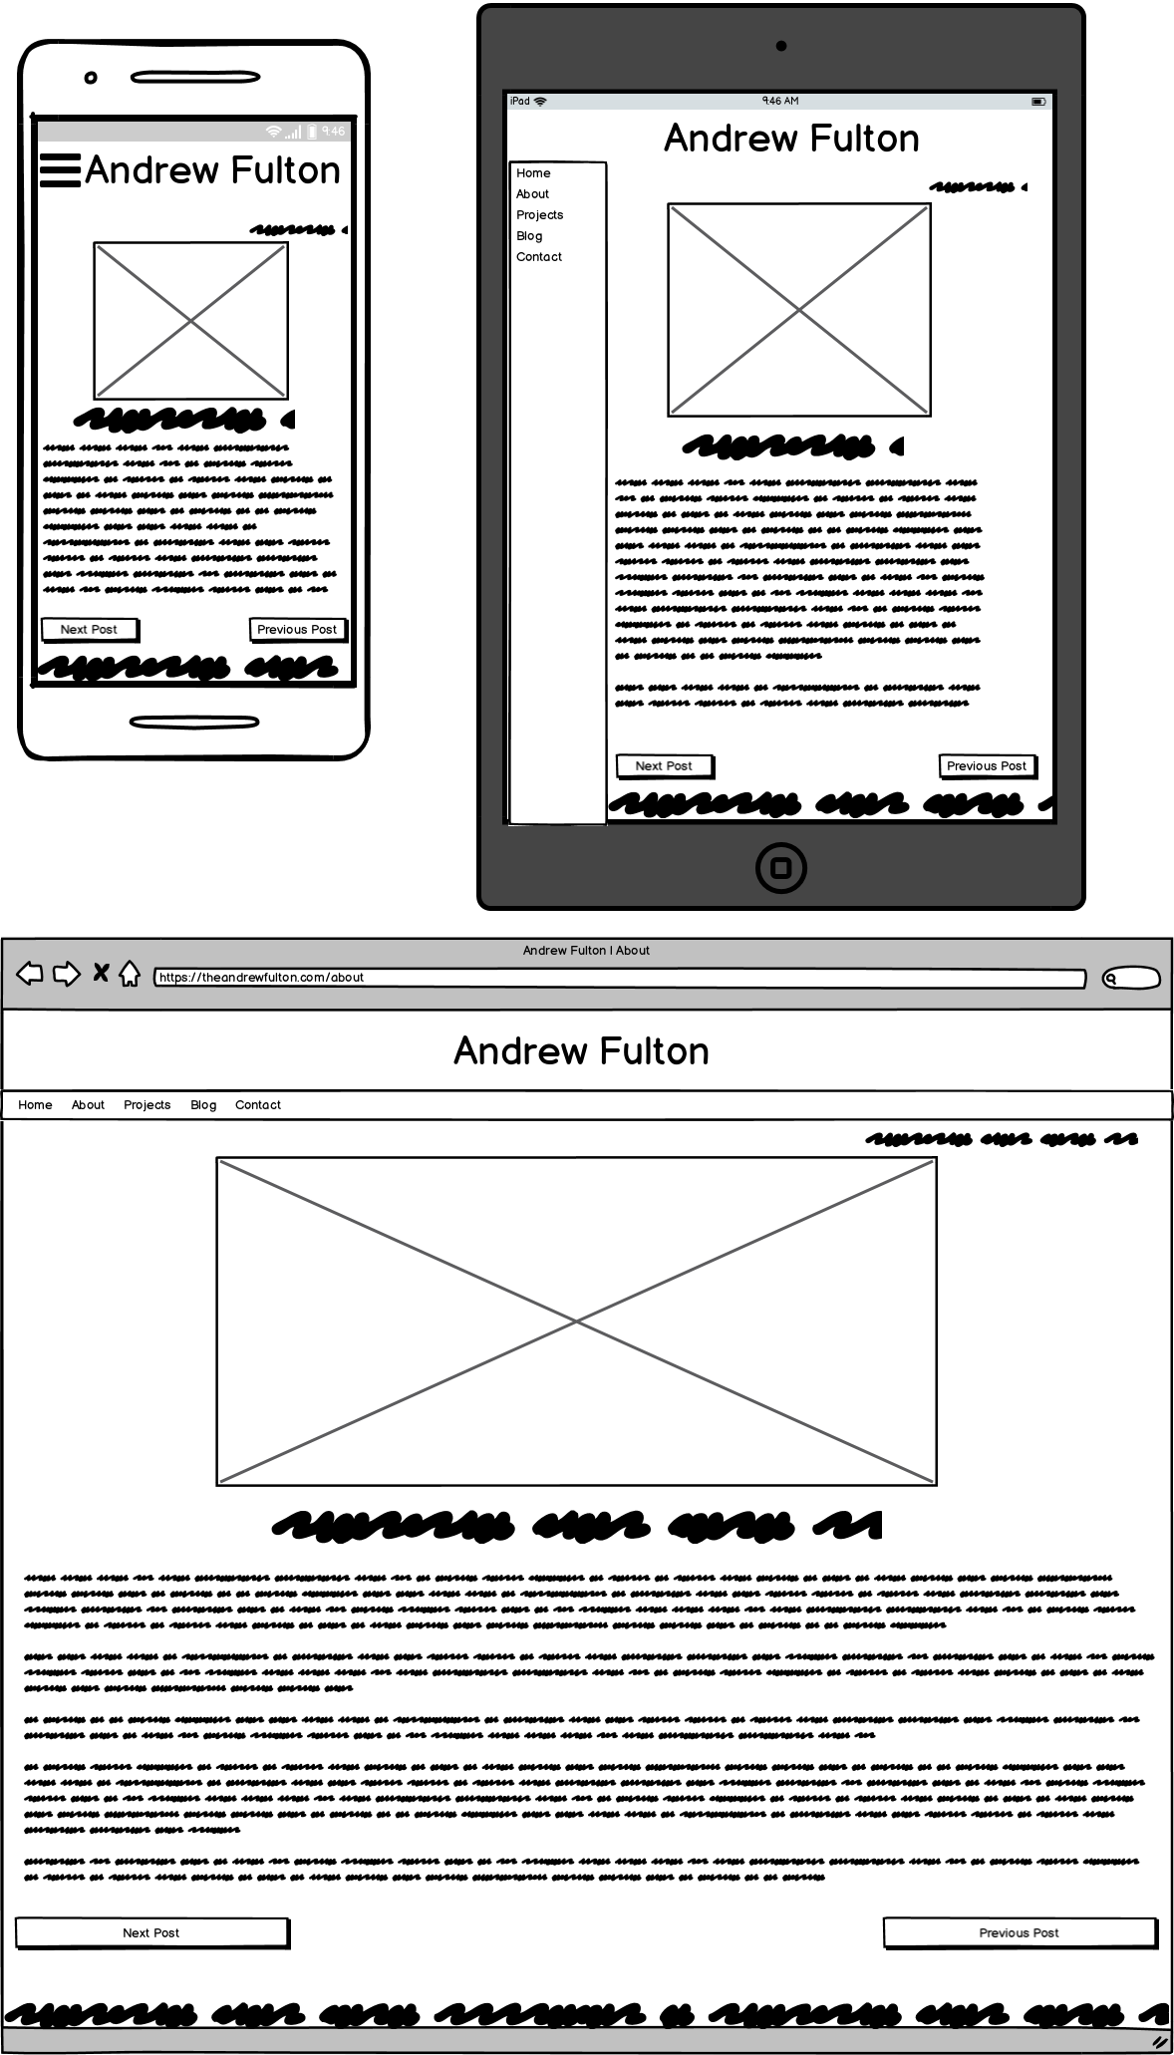
Remove this?

Slide 9
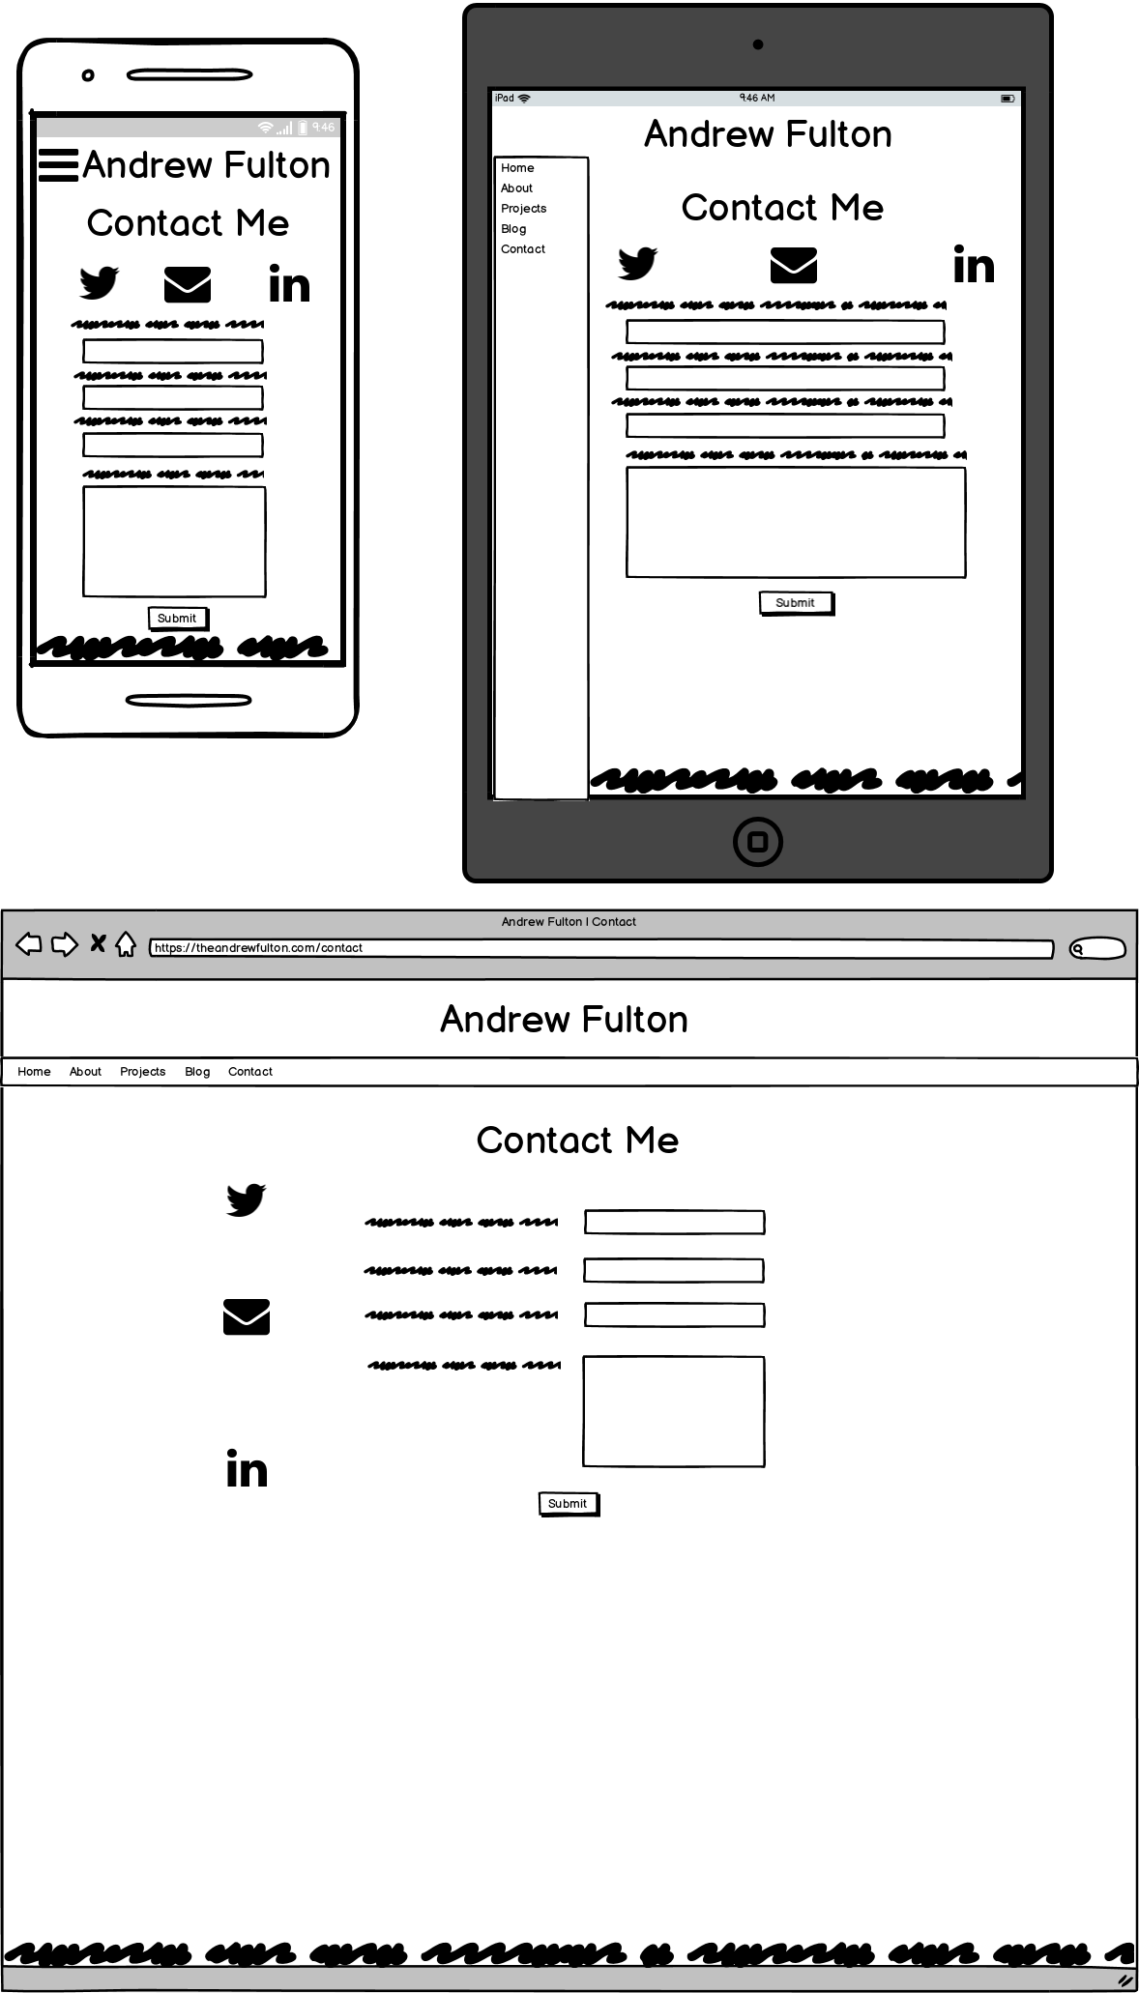

Slide 10
Highlight differences from concept
Homepage feature section

Slide 11
Elements
Blog and Portfolio
Introduction
4 components text, 4 components graphical
Icons
Blog Overview
Portfolio Overview
Blog Post/Feature

Slide 12
Slide deck list of components that will be used - and how components and styling will engage the audience.

Slide 13
Design Process and decisions
Sample portfolios
  Introduction from https://jacekjeznach.com
Wireframing
Hamburger Menu
Coolors

Slide 14
Walkthrough of Website and Features

Slide 15
Development /Build Process
Brief
Trello
Wireframes
Basic HTML
Basic CSS
Dynamic Webpages
Continuous build process
Challenges/issues/favourite parts

Slide 16
What could I do better???
Not sure if I should include this
Better responsive design
Homepage intro taking fill screen size

